Slide 1
Factor Analysis
Dr Quynh Nguyen
Part 1 – Introduction

Slide 2
Objectives
Notations and Terminology
Model Assumptions
Model Representation
Factor Rotations

Slide 3
Multivariate Problems
In hypothesis testing, to use techniques based on the general linear model to produce variables that are orthogonal
To compress a large number of variables into a smaller, more manageable dataset
To identify latent variables in large data sets that are represented by highly correlated input variables

Slide 4
Graphical Representation

Slide 5
Factors and components
Using factor analysis to find presence of latent variables, which explains the pattern of observed variables
Latent factors are assumed to actually exist, but cannot be measured directly
When you are not sure, how many latent variable exists for your latent factors and you want to check whether your models are correct or not, you conduct exploratory factor analysis (EFA) or common factor analysis
When you have some guesses or models for your latent factors and you want to check whether your models are correct or not, you conduct confirmatory factor analysis (CFA)
Factor analysis assumes the normality of the data, try not to use binary data

Slide 6
A original story of how FA came about - Measuring the Unmeasurable
In 1904, Charles Spearman, a British psychologist, proposed his “single factor” theory of intelligence.
Spearman sought to explain the relationships among various measures of mental ability by means of a single (underlying) ability, which he called general intelligence, or “g”.
Spearman believed that “g” was the common thread underlying performance on all tests of mental ability.
In his view, each mental test tapped a general mental ability and a specific ability.
Spearman’s g was a “latent” variable, in the sense that there did not exist independent operations and criteria for measuring it.
Spearman postulated that g existed, even though it was only evidenced indirectly by the battery of mental ability tests.

Slide 7
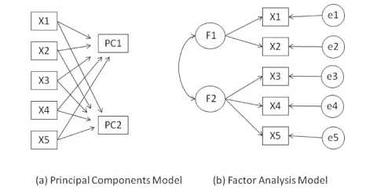
PCA vs FA
Use PCA to reduce the data into a smaller number of components.
Use FA to understand what constructs underlie the data.
In PCA analysis, the goal is to explain as much of the total variance in the variables as possible.
In FA, the goal is to explain the covariances or correlations between the variables.
The diagrams show the observed variables (X1 to X5), the principal components (PC1, PC2), factors (F1, F2), and errors (e1 to e5).
PCA is not testable measurement model, because how do we know if we have combined stuff correctly?
FA is a testable measure model, because we are trying to predict the observed covariances between indicators by creating factor – the factor is the reason for the covariance.

Slide 8
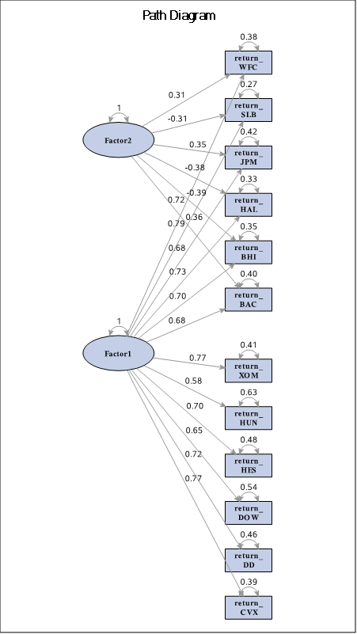
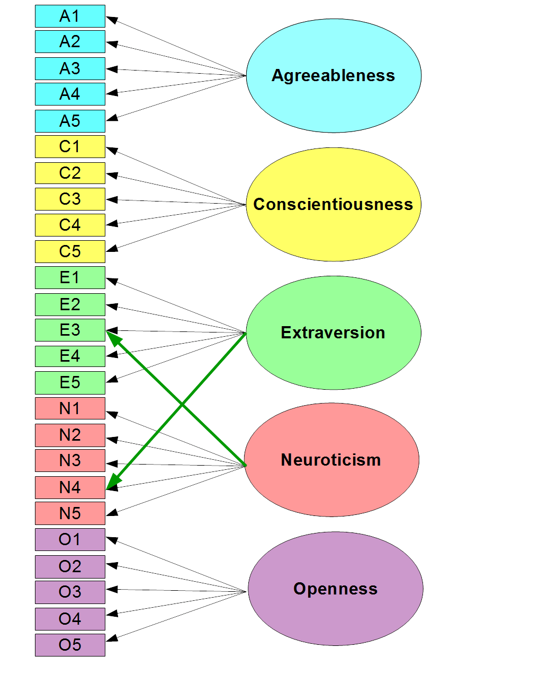

Slide 9
Type of Factor Analysis
Exploratory Factor Analysis (EFA)
Used during development a theory
Explore factor structure
Evaluate items
Confirmatory Factor Analysis
Validate a measure
Used after development

Slide 10




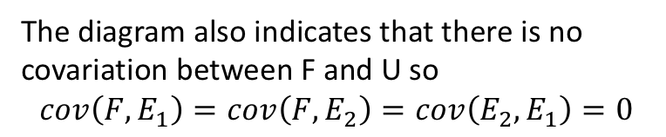









PCA FA
$$X_{1}$$
$$d_{1}$$
$$b_{1}$$
$$E_{1}$$
X₁
$$b_{1}$$
F
F
$$d_{2}$$
$$b_{2}$$
$$X_{2}$$
$$E_{2}$$
X₂
$$b_{2}$$
$X_{1}= b_{1}F +d_{1}$ $E_{1}$
[1]
$F = b_{1}X_{1}+b_{2}$ $X_{2}$
$X_{2}= b_{2}F +d_{2}$ $E_{2}$
The diagram also indicates that there is no covariation between F and U so
$$cov\left(F, E_{1}\right)=cov\left(F, E_{2}\right)=cov\left(E_{2}, E_{1}\right)=0$$
[2]
[1] and [2] describe a factor analytic linear system in the diagram

Slide 11
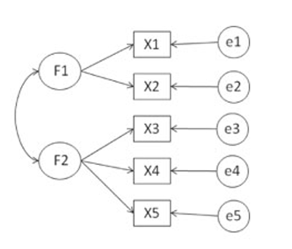
FA
Factors (F1 and F2) are assumed to underlie or “cause” the observed variables, rather than being linear combinations of them. The errors (e1 to e5) represent the variance in the observed variables unexplained by the factors.

Slide 12
FA vs PCA
Factor Analysis
PCA
Work on the basis of finding factors, eigen value, etc.
Aim to find and name the latent variables based on its attributes
After the factors are loaded, you try to gauge the latent variables
Attempt to achieve parsimony by explaining the maximum amount of common variance in a correlation matrix using the smallest number of constructs. These ‘constructs’ are called factors
Work on the basis of finding factors, eigen value, etc
No need to make sense of the latent variables (Principal components)
Mostly focus on deciding a number of components
Explain the maximum amount of total variance in a correlation matrix. It does this by transforming the original variables into a set of linear components

Slide 13
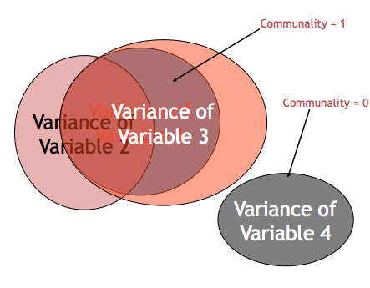
Terminologies
Measured variables – the real scores from the experiments – squares on a diagram
Latent variables – the construct the measured variables are supposed to represents – not measured directly – circles on a diagram
Variance Types
Common variance = overlapping variance between items (systematic variance)
Unique variance = variance only related to that item (error variance)
Communality – the common variance for the item

Slide 14
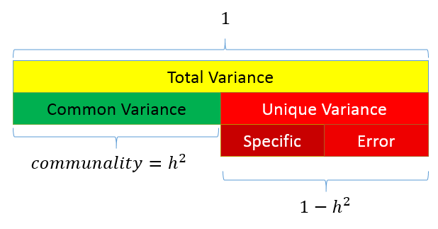
Partitioning the variance in Factor Analysis
The goal of factor analysis is to model the interrelationships among items, we focus primarily on the variance and covariance rather than the mean. Factor analysis assumes that variance can be partitioned into two types of variance, common and unique
Communality (also called h²) is a definition of common variance that ranges between 0 and 1. If communalities for a particular variable are low (between 0.0-0.4), then that variable may struggle to load significantly on any factor.
Specific variance: is variance that is specific to a particular item
Error variance: comes from errors of measurement and basically anything unexplained by common or specific variance
Notes:
Error variance is sth happened and cannot be explained. For example, the person got a call from her babysitter that her two-year old son ate her favorite lipstick.

Slide 15
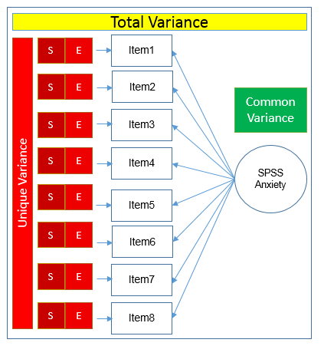
Partitioning the variance in Factor Analysis
The total variance is made up to common variance and unique variance, and unique variance is composed of specific and error variance. If the total variance is 1, then the communality is h² and the unique variance is 1−h².

Slide 16
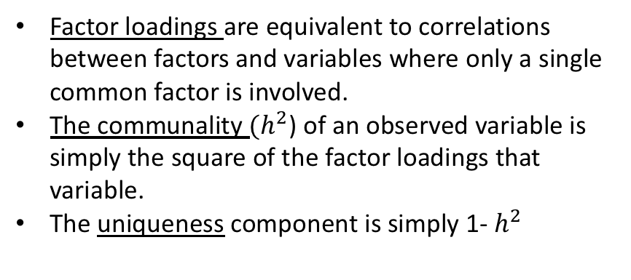
FA – Factor loadings
$$X_{1}$$
$$d_{1}$$
Factor loadings are equivalent to correlations between factors and variables where only a single common factor is involved.
The communality ${(h}^{2}$) of an observed variable is simply the square of the factor loadings that variable.
The uniqueness component is simply 1- $h^{2}$
$$b_{1}$$
$$E_{1}$$
F
$$d_{2}$$
$$b_{2}$$
$$X_{2}$$
$$E_{2}$$
$X_{1}= b_{1}F +d_{1}$ $E_{1}$
[1]
$X_{2}= b_{2}F +d_{2}$ $E_{2}$
The diagram also indicates that there is no covariation between F and U so
$$cov\left(F, E_{1}\right)=cov\left(F, E_{2}\right)=cov\left(E_{2}, E_{1}\right)=0$$
[2]
[1] and [2] describe a factor analytic linear system in the diagram

Slide 17
Why Do an Exploratory Factor Analysis?
Structural Exploration
Data Reduction
Attribute Scoring

Slide 18

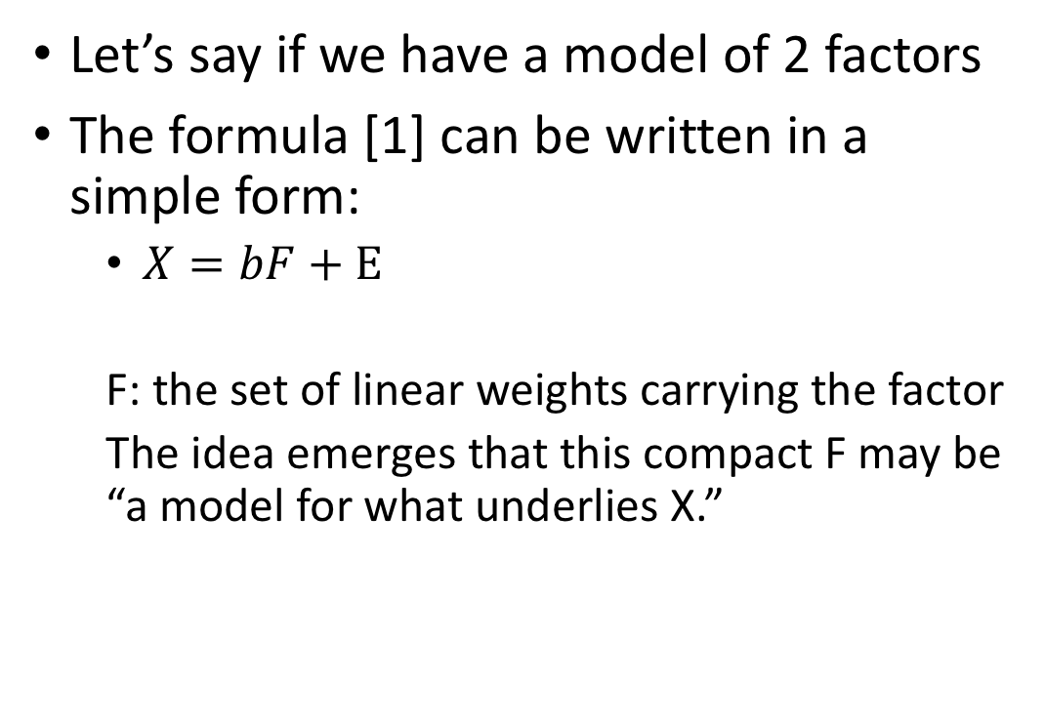

Why Do an Exploratory Factor Analysis? - Structural Exploration
Let’s say if we have a model of 2 factors
The formula [1] can be written in a simple form:
$X=bF+E$
F: the set of linear weights carrying the factor
The idea emerges that this compact F may be “a model for what underlies X.”
$$X_{1}$$
$$d_{1}$$
$$b_{1}$$
$$E_{1}$$
F
$$d_{2}$$
$$b_{2}$$
$$X_{2}$$
$$E_{2}$$
$X_{1}= b_{1}F +d_{1}$ $E_{1}$
[1]
$X_{2}= b_{2}F +d_{2}$ $E_{2}$

Slide 19
Two main steps in Factor Analysis
Extracting Factors: involves making a choice about the type of model as well the number of factors to extract
Rotating Factors: comes after the factors are extracted, with the goal of achieving simple structure in order to improve interpretability.

Slide 20
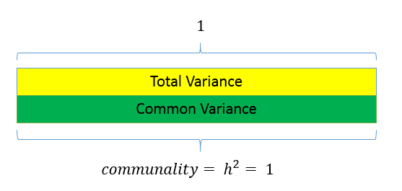
1. Extracting Factors
Principal components analysis: PCA makes the assumption that there is no unique variance, the total variance is equal to common variance. If there is no unique variance then common variance takes up total variance
Common factor analysis: assumes that total variance can be partitioned into common and unique variance. It is usually more reasonable to assume that you have not measured your set of items perfectly. The unobserved or latent variable that makes up common variance is called a factor. If you believe there is some latent construct that defines the interrelationship among items, then factor analysis may be more appropriate
Notes:
Both types of factor analyses are based on the Common Factor Model, illustrated in figure 1.1. This model proposes that each observed response (measure 1 through measure 5) is influenced partially by underlying common factors (factor 1 and factor 2) and partially by underlying unique factors (E1 through E5)

Slide 21
1. Common factor analysis
Maximum likelihood (ml) – factanal() in the stats package or fa() in psych package
Weighted least square (wls)
Generalized weighted least squares (gls)
Minimum residual (minres)
iterated principal axis (pa),

Slide 22
Step to conduct EFA

Slide 23
Is data suitable for the FA test – sample size
The normal set of data screening rules.
What about additivity?
You want items to be correlated
Correlation test
Correlation adequacy Bartlett's test: Bartlett's test of sphericity tests the hypothesis that your correlation matrix is an identity matrix, which would indicate that your variables are unrelated and therefore unsuitable for structure detection. Small values (less than 0.05) of the significance level indicate that a factor analysis may be useful with your data
Notes:
Bartlett’s Test of Sphericity compares an observed correlation matrix to the identity matrix. Essentially it checks to see if there is a certain redundancy between the variables that we can summarize with a few number of factors.
Identity matrix meaning that all the diagonal terms are one and all off-diagonal terms are zero.
The null hypothesis of the test is that the variables are orthogonal, i.e. not correlated.
We want to look for <-.05 because we want the variables to be correlated.

Slide 24
Is data suitable for the FA test – Power
Sample size suggestions
10-15 participants per item or 20 participants per item
<100 is not acceptable
ARGUE LOTS OF MONTE CARLOS!
300 is the most agreed upon best bet
1000+ would be considered as excellent for FA/EFA/CFA
Now data is a lot hence, we might not face with the issue of small sample size. Even when the sample size is very large and if the communality is low, no matter how large the sample size is, the estimation of the factor loadings (pattern/structure coefficients) will not be accurate.
KMO measure of sampling adequacy is used to compare the magnitudes of the observed correlation coefficients in relation to the magnitudes of the partial correlation coefficient. Large KMO values are good because between pairs of variables can be explained by the other variables.
Notes:
KMO tests whether there are a significant number of factors in the dataset.
The range of KMO is from 0.0 to 1.0 and desired values are > 0.5

Slide 25
How many factors/components do I have?
Ways to determine number to extract
Theory
Kaiser criterion
Scree Plots
Parallel Analysis

Slide 26
How many factors/components do I have?
Theory
Usually you have an idea of the number of latent constructs you expect
You made the scale that way
Previous research

Slide 27
How many factors/components do I have?
Kaiser criterion
Note this is sometimes still used, but usually not recommended
Old rule: extract the number of eigenvalues over 1
New rule: extract the number of eigenvalues over .7

Slide 28
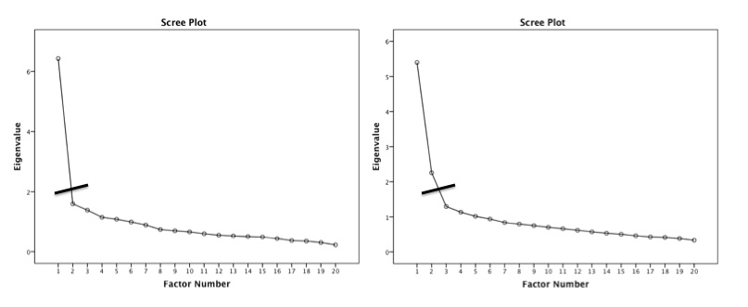
How many factors/components do I have?
Scree plot – a graphical representation of eigenvalues
Look for a large drop

Slide 29
How many factors/components do I have?
Parallel Analysis – a statistical test to tell you how many eigenvalues are greater than chance
Calculates the eigenvalues for your data
Randomizes your data and recalculates the eigenvalues
Then compares them to determine if they are equal
Parallel Analysis in R: fa.parallel()
Notes:
PA is used to determine as how many PC or FA to keep.
So data with p values with produce p eigenvalues

Slide 30
How many factors/components do I have?
What to do if they disagree?
Test both models to determine which works better
Simpler solutions are better (i.e. less factors)

Slide 31
Factor Rotation
Even though EFA identifies latent directions in the data, there is no guarantee that these directions are inherently interpretable
Rotation the axes of the factor so that low loadings become lower and high loadings larger
Rotation redistributes the variance across factors to aid in interpretation
This may change the eigenvalues of each factor, but not their sum (because that rotation does not change the fit or the amount of variance explained)
Orthogonal rotations such as ‘varimax’ try to rotate the factors to obtain simple structure while keeping the directions at 90 degrees to each other (uncorrelated). -> This has the advantage of keeping the standardized factor loadings in correlational units.
Oblique rotations allow for the factors to correlate, but are still motivated to achieve simple structure of the loading matrix. In general, assuming that factors are uncorrelated is probably a bad, or at least questionable

Slide 32
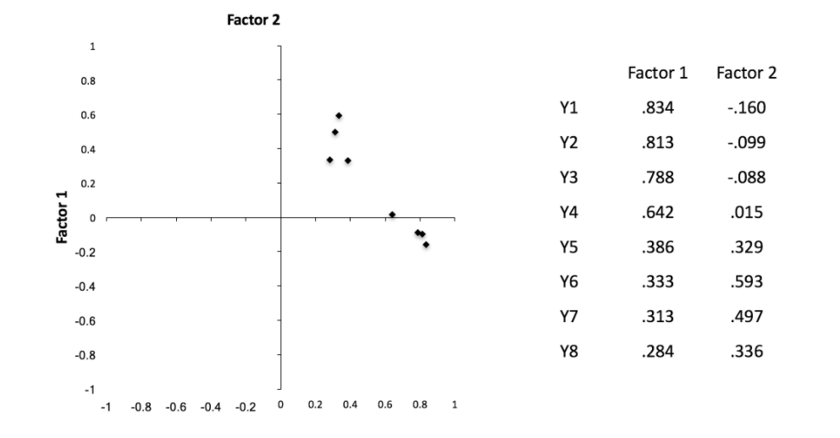
Factor Rotation Example – No Rotation

Slide 33
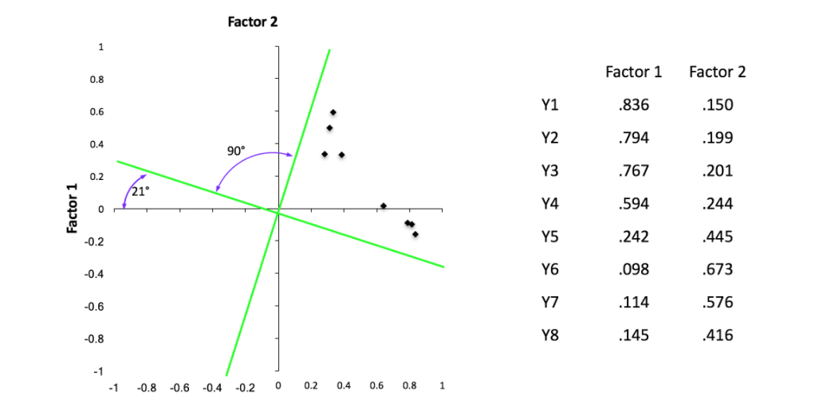
Factor Rotation Example – Orthogonal Rotation

Slide 34
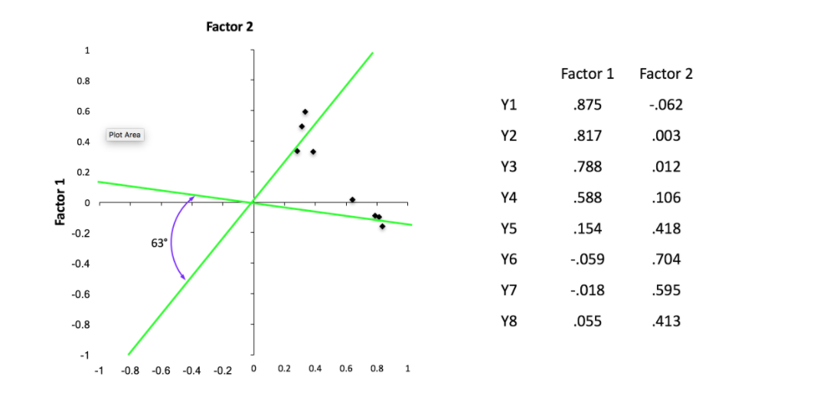
Factor Rotation Example – Oblique

